Slide 1
MB Project

Slide 2
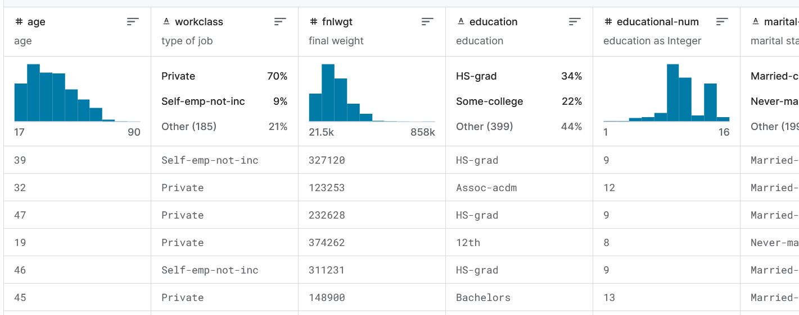
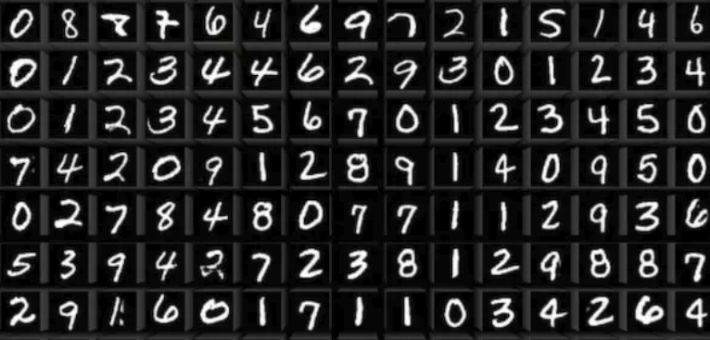
Datasets
Income Dataset: This dataset was used for working with numerical dataset in the cGAN model. The primary purpose of this was to generate similar type of data. This contains categorical as well as numerical data.
MNIST Dataset: This dataset contains images of handwritten digits. It contains 50000 images each of size 28x28. It’s primary role was to evaluate the basic image generate capabilities of our model.

Slide 3
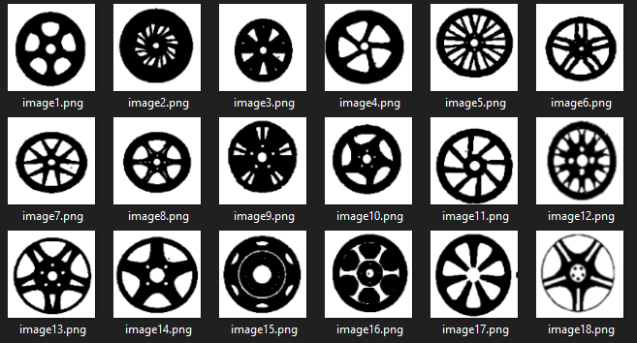
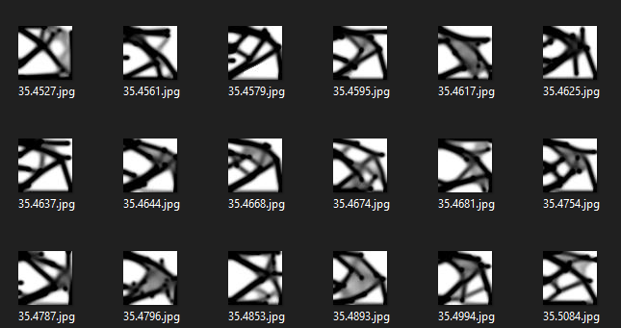
Datasets
Wheels Dataset: This dataset contains 4000 images of wheel cross sections. This was the primary dataset onto which our models were tested.
Structural Dataset: This dataset contains 4000 images of machine structures. This is labeled dataset each image having a corresponding stiffness value associated with it.

Slide 4
Note
All the experiments were performed on images of size 32x32 or lower. Increasing the size of images gave out of memory error.
All the experiments were performed on T4 GPU with 64GB RAM.
The main aim was to experiment with different types of diffusion models.

Slide 5
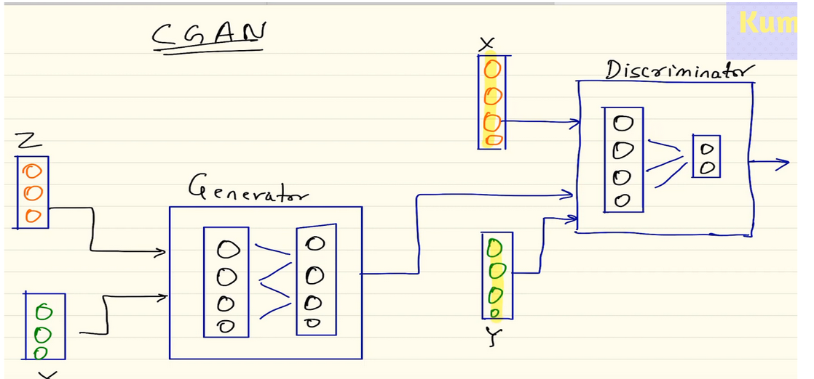
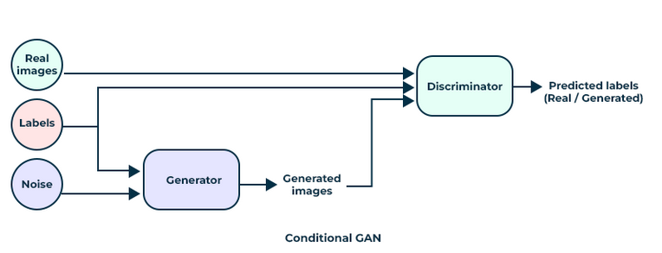
Conditional GAN’s (cGAN)
The generator intakes random noise + labels to generate an image belonging to that particular class.
Discriminators need to train on two aspects 1) Detect whether the image is real or fake and 2) To which class it belongs. If any of the above criteria goes wrong (like the real image but the wrong label or vice-versa), the Discriminator classifies the sample as fake(0) or otherwise real(1).

Slide 6
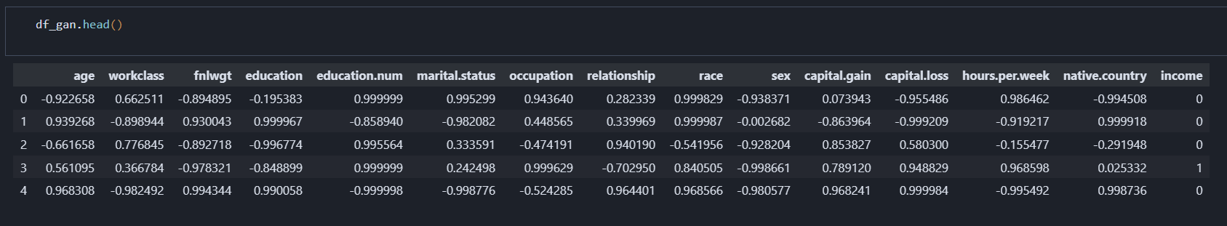
Conditional GAN’s (cGAN)
Input data: The model was trained on income dataset obtained from Kaggle. It generated similar data with 14 columns (numerical and categorical).
The model didn’t work appropriately with categorical data and generated numerical data with great accuracy.
Output:

Slide 7
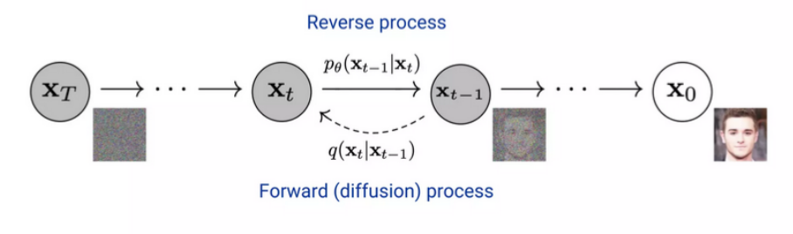
Diffusion Models
Diffusion models are iterative denoising autoencoder that progressively enhance an image to achieve a final, clean and denoised output.
Diffusion model aims to learn the reverse of noise generation procedure.
Forwards Step: Add noise to the original sample. The samples x0 converges to complete noise xt.
Reverse Step: Recover the original sample from the noise. This is the generation process

Slide 8
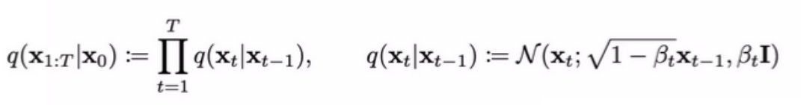
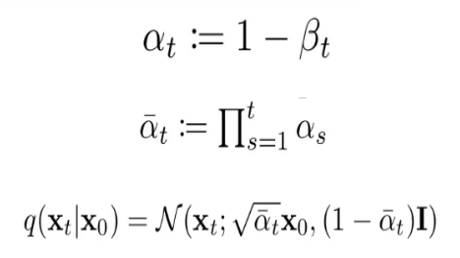

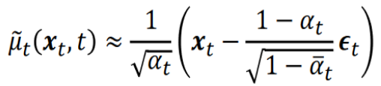
Maths behind Diffusion models
Forward step:
The final step can be obtained directly from the original image using the below formula:
Reverse Step:
We learn the parameters, 𝛍_{𝜭} and Σ_{𝜭.}
We do not know the actual value of 𝛍_{𝜭}, but e_{t} can be approximated by a neural network.

Slide 9
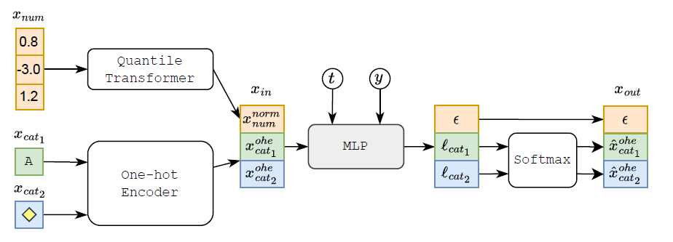
TABDDPM
This generates tabular data using stable diffusion.
The data can be numerical as well as categorical.
Architecture:

Slide 10
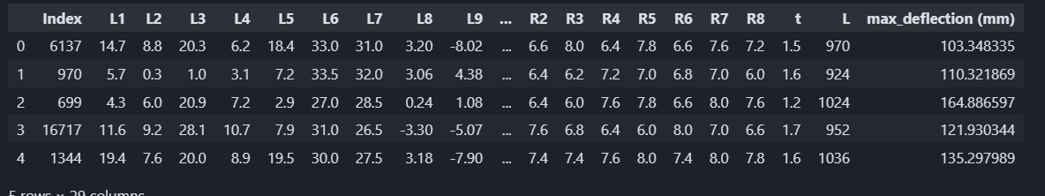
Results of TabDDPM
TabDDPM produces more realistic feature distributions compared to TVAE and CTABGAN+.
TabDDPM significantly outperforms GAN and VAE baselines on most datasets, which highlights the advantage of diffusion models for tabular data.
Output of TabDDPM on Income dataset

Slide 11
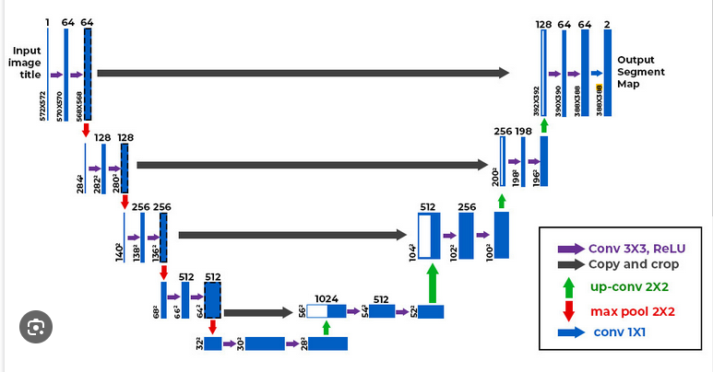
UNET Model
It consists of blocks which are used in every layer of our model.
Every block includes a batch Norm, Conv2d operation, ReLU function, and again normlization.

Slide 12
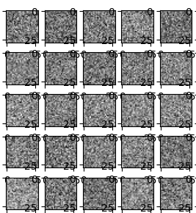
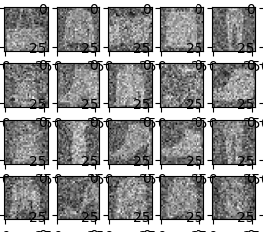
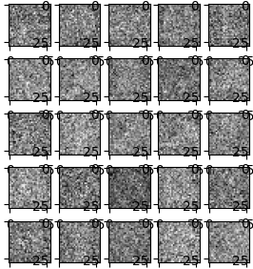
UNET Model
UNET model was tested on Fashion-MNIST dataset.
Results of forward process:

Slide 13
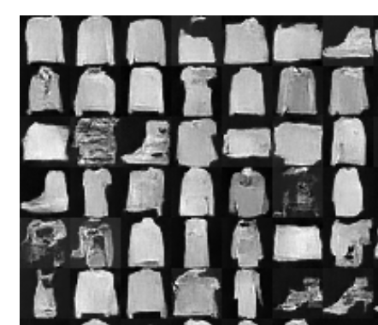
Final results from UNET model
I wasn’t able to modify the code such that it includes our data and thus wasn’t able to get results for any other dataset.

Slide 14
Denoising Diffusion Probablistic Models
DDPMs provide a flexible framework for generative modeling by leveraging both probabilistic and neural network-based approaches
This was another model that was tested on the datasets. This model gave good results on the wheel and structural datasets.
All the below experiments are performed for 300 epochs and learning rate 0.01.

Slide 15
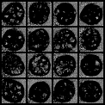
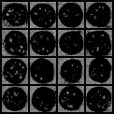
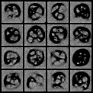
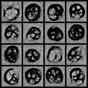
2D Wheels dataset
The initial outputs were very absurd:
Upon seeing this, I increased the models complexity, added some layers and changed the hyper-parameters. I also increased the number of epochs to 600. The result improved but still not very clear:

Slide 16
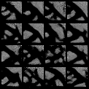
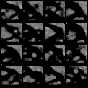
Structural Dataset output

Slide 17
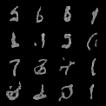
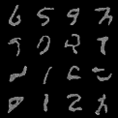
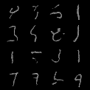
MNIST Dataset output
Outputs for the MNIST dataset:

Slide 18
Problems with DDPM model
The results of DDPM models didn’t improve even after taking the below steps:
I first changed the hyper-parameters like learning rate, batch size etc.
I also change the architecture of the neural network in DDPM Module.
Tried to increase the number of epochs.
Even after the above change DDPM model gave similar results and I moved onto trying with Noise Condition Score Networks

Slide 19
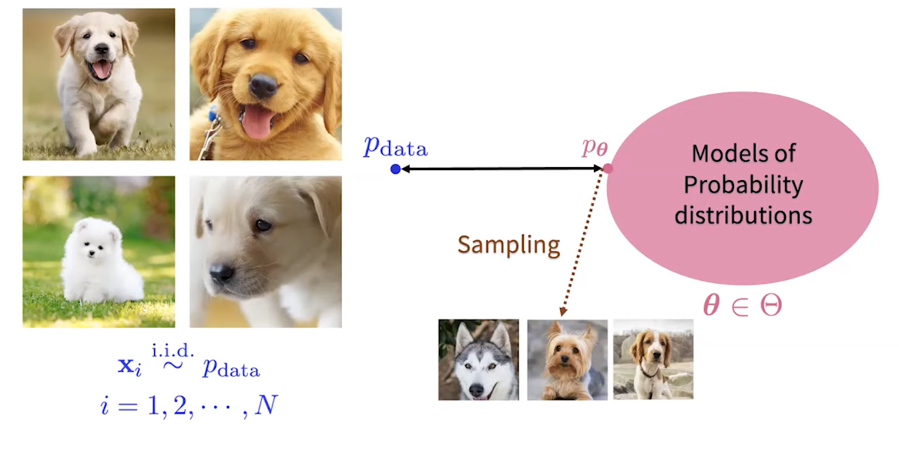
Noise Condition Score Networks
Challenges: The data distribution is extremely complex for high dimensional data. Difficult to build such a model which can fit in the data distribution.
Another challenge is finding the normalization constant which helps to normalize the final results.

Slide 20

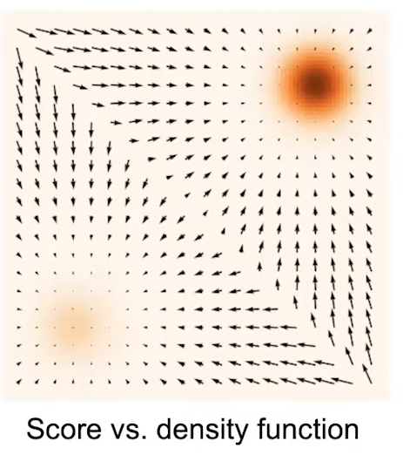
Score Functions
This is a vector and gives the direction in which density function is at it’s maximum.
Computationally score function is much easier to work with than the density function.
Score functions bypass the need for normalizing constant.
They generally gives results better than GAN’s and give a better estimation of data distribution.

Slide 21
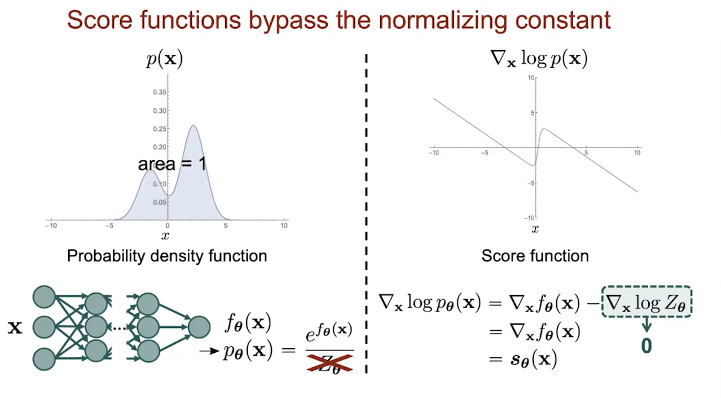
Bypassing the normalization constant

Slide 22


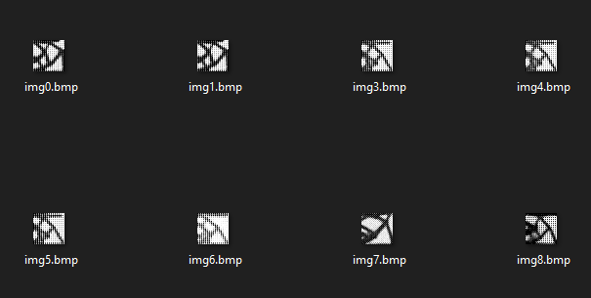
Outputs of NCNS

